Slide 1


CS-446: Information Systems Security
Lecture # 22: Control Hijacking Attacks and Defenses
Prof. Dr. Sufian Hameed
Department of Computer Science
FAST-NUCES

Slide 2
This Lecture
Basic Control Hijacking Attacks
More Control Hijacking Attacks
Format String Bugs
Platform Defenses
Run-Time Defenses
Advance Hijacking Attacks

Slide 3
Basic Control Hijacking Attacks
Notes:
In computer security and programming, a buffer overflow, or buffer overrun, is an anomaly where a program, while writing data to a buffer, overruns the buffer's boundary and overwrites adjacent memory. This is a special case of violation of memory safety.
Buffer overflows can be triggered by inputs that are designed to execute code, or alter the way the program operates. This may result in erratic program behavior, including memory access errors, incorrect results, a crash, or a breach of system security. Thus, they are the basis of many software vulnerabilities and can be maliciously exploited.
Programming languages commonly associated with buffer overflows include C and C++, which provide no built-in protection against accessing or overwriting data in any part of memory and do not automatically check that data written to an array (the built-in buffer type) is within the boundaries of that array. Bounds checking can prevent buffer overflows.

Slide 4
Control hijacking attacks
Attacker’s goal:
Take over target machine (e.g. web server, email server …)
Execute arbitrary code on target by hijacking application control flow
Examples.
Buffer overflow attacks
Integer overflow attacks
Format string vulnerabilities
Notes:
Control hijacking attacks that exploit very common vulnerability based on buffer overflow and other types of overflow.
Very common attacks and need to discuss this so when you write code, your code wont be vulnerable to these attacks.

Slide 5
Example 1: Buffer Overflows
Extremely common bug in C/C++ programs.
First major exploit: 1988 Internet Worm (moris worm)
20% of all vuln.
2005-2007: ≈ 10%
Source: NVD/CVE
Notes:
Few statistics about how prevalent these bugs are.
Y-axis is the number of software product vulnerable to Beffer Overflows

Slide 6
What is needed
Understanding C functions, the stack, and the heap.
Know how system calls are made
The exec() system call
Attacker needs to know which CPU and OS used on the target machine:
Our examples are for x86 running Linux or Windows
Details vary slightly between CPUs and OSs:
Little endian vs. big endian (x86 vs. Motorola)
Stack Frame structure (Unix vs. Windows)
Notes:
How stacks are allocated or deallocated
How memory management works on Heap ?
If we run exec(binsell()) then binshell will become a shell process and starts executing

Slide 7
Linux process memory layout
0xC0000000
user stack
%esp
shared libraries
0x40000000
brk
run time heap
Loaded from exec
0x08048000
unused
0
Notes:
The process is loaded in to Exec and grows upward. And memory is allocated in heap.
Stack grow downwards
Stack pointer (extended stack pointer) point to the bottom of the stack.

Slide 8
Stack Frame (created every time a new function is invoked)
high
arguments
return address
stack frame pointer
exception handlers
local variables
Stack
Growth
callee saved registers
SP
low
Notes:
Every time a function is called a new stack frame is created.
In windows exception handler is pushed in stack after stack frame pointers.
SP (stack pointer at the bottom)
Saved Registers are recovered when the function exits

Slide 9
What are buffer overflows?
Suppose a web server contains a function:
void func(char *str) { char buf[128];
strcpy(buf, str); do-something(buf); }
When func() is called stack looks like:
argument: str
return address
stack frame pointer
char buf[128]
SP
Notes:
Lets take an example of a function which takes in argument char *str and lets pretend that this function is part of a webservice and string is the url

Slide 10
What are buffer overflows?
What if *str is 136 bytes long?
After strcpy:
void func(char *str) { char buf[128];
strcpy(buf, str); do-something(buf); }
argument: str
return address
stack frame pointer
*str
char buf[128]
Problem: no length checking in strcpy()
SP
Notes:
It will overflow the stack frame pointer and the return address will also change.
The function will return to a address given by the user

Slide 11
Basic stack exploit
Suppose *str is such that after strcpy stack looks like:
Program P: exec(“/bin/sh”)
When func() exits, the user gets shell !
Note: attack code P runs in stack.
Program P
high
(exact shell code by Aleph One)
return address
char buf[128]
low
Notes:
How to we exploit this ?
This will overflow the machine code. (there are more things than this)
You enter a url and what comes back is a shell prompt and then you can run arbitrary instructions.
One of the Defense is actually to mark the stack as non-execute
A lot of effort has been put into writing clever shell codes. Now there are actual machine readable alpha numeric shell codes

Slide 12
The NOP slide
Program P
high
Problem: how does attacker determine ret-address?
Solution: NOP slide
Guess approximate stack state when func() is called
Insert many NOPs before program P:
nop , xor eax,eax , inc ax
NOP Slide
return address
char buf[128]
low
Notes:
How does the attacker know what the return attacks is ? He should know the state of the stack to know where he needs to jump into.
NOP instructions doesn’t do anything to the control flow.
After the NOPs the program P will execute and the attacker will get the Shell. So with NOP slides the attacker does need to know where the program is loaded

Slide 13
Details and examples
Some complications:
Program P should not contain the ‘\0’ character.
Overflow should not crash program before func() exists.
Sample remote stack smashing overflows:
(2007) Overflow in Windows animated cursors (ANI). LoadAniIcon()
(2005) Overflow in Symantec Virus Detection
test.GetPrivateProfileString "file", [long string]
Notes:
Animated cursor on web page or email message would result in arbitrary code execution. Used for rendering cursors, animated cursors, and icons.

Slide 14
Many unsafe libc functions
strcpy (char *dest, const char *src)
strcat (char *dest, const char *src)
gets (char *s)
scanf ( const char *format, … ) and many more.
“Safe” libc versions strncpy(), strncat() are misleading
e.g. strncpy() may leave string unterminated.
Windows C run time (CRT):
strcpy_s (*dest, DestSize, *src): ensures proper termination
Notes:
All those have no bound checking which can result in Buffer Overflow

Slide 15
Buffer overflow opportunities
Exception handlers: (Windows SEH attacks)
Overwrite the address of an exception handler in stack frame.
Function pointers: (e.g. PHP 4.0.2, MS MediaPlayer Bitmaps)
Overflowing buf will override function pointer.
Longjmp buffers: longjmp(pos) (e.g. Perl 5.003)
Overflowing buf next to pos overrides value of pos.
Heap or stack
buf[128]
FuncPtr
Notes:
Windows media player bitmaps (skins) – heap overflow, Feb. 2006
setjmp – used for exception handling (jump to global error handling code in case of error)
There is not just buffer overflow

Slide 16
Corrupting method pointers
Compiler generated function pointers (e.g. C++ code)
After overflow of buf :
method #1
FP1
ptr
FP2
method #2
FP3
method #3
data
vtable
Object T
NOP slide
shell code
buf[256]
vtable
ptr
data
object T

Slide 17
Finding buffer overflows
To find overflow:
Run web server on local machine
Issue malformed requests (ending with “$$$$$” )
Many automated tools exist (called fuzzers – next module)
If web server crashes
search core dump for “$$$$$” to find overflow location (heap, stack)
Construct exploit (not easy given latest defenses)

Slide 18
More Control Hijacking Attacks
Notes:
These attacks are real and the reason we are teaching you is so that when you will write your code carefully

Slide 19
More Hijacking Opportunities
Integer overflows: (e.g. Use to attack MS DirectX MIDI Lib)
Double free: double free space on heap.
Can cause memory mgr to write data to specific location
Examples: CVS server
Format string vulnerabilities

Slide 20
Integer Overflows (Phrack issue 60)
Problem: what happens when int exceeds max value?
int m; (32 bits) short s; (16 bits) char c; (8 bits)
c = 0x80 + 0x80 = 128 + 128 ⇒ c = 0
s = 0xff80 + 0x80 ⇒ s = 0
m = 0xffffff80 + 0x80 ⇒ m = 0
Can this be exploited?
Notes:
Phrack (v popular computer security magazine) issue number 60

Slide 21
An example
void func( char *buf1, *buf2, unsigned int len1, len2) {
char temp[256];
if (len1 + len2 > 256) {return -1} // length check
memcpy(temp, buf1, len1); // cat buffers
memcpy(temp+len1, buf2, len2);
do-something(temp); // do stuff
}
What if len1 = 0x80, len2 = 0xffffff80 ?
⇒ len1+len2 = 0
Second memcpy() will overflow heap !!
Notes:
How will you fix this problem ?
Ensure that Len1 and Len2 are each less than 256

Slide 22
Integer overflow exploit stats
Source: NVD/CVE
Notes:
Number of Product that are vulnerable of Overflow attacks

Slide 23
Format String Bug

Slide 24
Format string problem
int func(char *user) {
fprintf( stderr, user);
}
Problem: what if *user = “%s%s%s%s%s%s%s” ??
Most likely program will crash: DoS.
If not, program will print memory contents. Privacy?
Full exploit using user = “%n” (directive to allow writing in memory)
Correct form (always be explicit about your format string ): fprintf( stdout, “%s”, user);
Notes:
The Format String exploit occurs when the submitted data of an input string is evaluated as a command by the application
stderr stands for standard error device.
Standard error is another output stream typically used by programs to output error messages or diagnostics. In console programming it is the console -- the screen. It is essentially the same as stdout. The general practice is to redirect all error messages to stderr and all regular output to stdout. The reason is that it is possible to redirect standard output to a file instead of the screen. So If you perform a "dir > dirlist.txt" command on command prompt the directory listing goes into the text file instead of screen. If you code to redirect error messages to stderr, the error will always go to the screen instead of the file so that the user could be warned immediately instead of ending up seeing unexpected results in the file.

Slide 25
History
First exploit discovered in June 2000.
Examples:
wu-ftpd 2.* : remote root
Linux rpc.statd: remote root
IRIX telnetd: remote root
BSD chpass: local root

Slide 26
Vulnerable functions
Any function using a format string.
Printing:
printf, fprintf, sprintf, …
vprintf, vfprintf, vsprintf, …
Logging:
syslog, err, warn

Slide 27
Exploit
Dumping arbitrary memory:
Walk up stack until desired pointer is found.
printf( “%08x.%08x.%08x.%08x|%s|”)
Writing to arbitrary memory:
printf( “hello %n”, &temp) -- writes ‘6’ into temp.
printf( “%08x.%08x.%08x.%08x.%n”)
Notes:
“%08x = process the next 8 bytes in the stack

Slide 28
Platform Defenses

Slide 29
Preventing hijacking attacks
Fix bugs:
Audit software
Automated tools: Coverity, Prefast/Prefix.
Rewrite software in a type safe languange (Java, ML)
Difficult for existing (legacy) code …
Concede overflow, but prevent code execution
Add runtime code to detect overflows exploits
Halt process when overflow exploit detected
StackGuard, LibSafe, …
Notes:
Just impossible to fix all the code

Slide 30
Marking memory as non-execute (W^X)
Prevent attack code execution by marking stack and heap as non-executable
NX-bit on AMD Athlon 64, XD-bit on Intel P4 Prescott
NX bit in every Page Table Entry (PTE)
Deployment:
Linux (via PaX project); OpenBSD
Windows: since XP SP2 (DEP: Data execution protection)
Boot.ini : /noexecute=OptIn or AlwaysOn
Visual Studio: /NXCompat[:NO]
Limitations:
Some apps need executable heap (e.g. JITs).
Does not defend against `return-to-libc’ exploits
Notes:
W^X memory pages are either writable or executable but not both.
NX bit non-executable bit in every page table entry
XD execute disable
OptIn: Windows processes are protected. Other apps must OptIn for protection using sysdm.cpl program.
/NXCOMPAT: tells linker that app is compatible with DEP. :NO indicates don’t use DEP.
DEP: data execute prevention

Slide 31
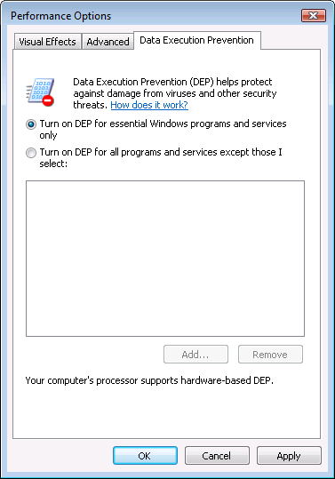
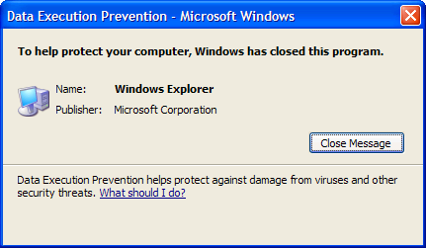
Examples: DEP controls in Windows
DEP terminating a program

Slide 32
Attack: return to libc
Control hijacking without executing code
stack
libc.so
args
ret-addr
exec()
sfp
printf()
local buf
“/bin/sh”
Notes:
NX wasted effort?
Common runtime library for C.
So with this return oriented programming you can run your code without actually specifying your code.

Slide 33
Response: randomization
ASLR: (Address Space Layout Randomization)
Map shared libraries to rand location in process memory
⇒ Attacker cannot jump directly to exec function
Deployment: (/DynamicBase)
Windows Vista: 8 bits of randomness for DLLs
aligned to 64K page in a 16MB region ⇒ 256 choices
Linux (via PaX): 16 bits of randomness for libraries
More effective on 64-bit architectures
Other randomization methods:
Sys-call randomization: randomize sys-call id’s
Instruction Set Randomization (ISR)
Notes:
Somehow make the location of Libc to a random location
Combination of NX and ASLR is effective.
/DynamicBase: Visual Studio flag to indicate that application works with ASLR.

Slide 34
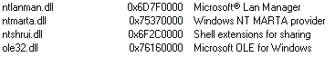
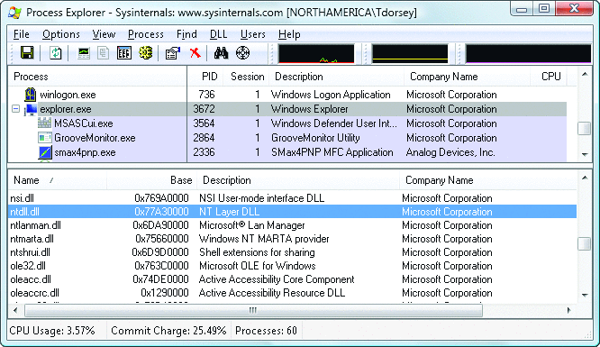
ASLR Example
Booting twice loads libraries into different locations:

Slide 35
Some attacks remain: JiT spraying
Idea:
Force Javascript JiT to fill heap with executable shellcode
then point SFP anywhere in spray area
NOP slide
shellcode
execute enabled
execute enabled
heap
vtable
execute enabled
execute enabled
Notes:
Bion Blazakis [Blakchat 2010]
JiT has to turnoff DEP
A better defense would be isolation which will be discuss later

Slide 36
Run-Time Defenses
Notes:
Compiler based defenses and linker based defenses. All are very elegant ideas

Slide 37
Run time checking: StackGuard
Many run-time checking techniques …
we only discuss methods relevant to overflow protection
Solution 1: StackGuard
Run time tests for stack integrity.
Embed “canaries” in stack frames and verify their integrity prior to function return.
Frame 2
Frame 1
top of stack
local
canary
sfp
ret
str
local
canary
sfp
ret
str
Notes:
Local variable will overflow through the canary.
When the function will return it will check of the canary is valid. Only if the Canary is valid it will return

Slide 38
Canary Types
Random canary:
Random string chosen at program startup.
Insert canary string (4-8 bytes) into every stack frame.
Verify canary before returning from function.
Exit program if canary changed. Turns potential exploit into DoS.
To corrupt, attacker must learn current random string.
Terminator canary: Canary = {0, newline, linefeed, EOF}
String functions will not copy beyond terminator.
Attacker cannot use string functions to corrupt stack.
Not used as often

Slide 39
StackGuard (Cont.)
StackGuard implemented as a GCC (compiler) patch.
Program must be recompiled.
Minimal performance effects: 8% for Apache.
Note: Canaries don’t provide full proof protection.
Some stack smashing attacks leave canaries unchanged
Heap protection: PointGuard.
Protects function pointers and setjmp buffers by encrypting them: e.g. XOR with random cookie
Less effective, more noticeable performance effects
Notes:
With Point guard ---- randomization is added and the pointer wont point to where-ever the attacker wants

Slide 40
StackGuard enhancements: ProPolice
ProPolice (IBM) - gcc 3.4.1. (-fstack-protector)
Rearrange stack layout to prevent ptr overflow.
args
String Growth
Protects pointer args and local pointers from a buffer overflow
ret addr
SFP
CANARY
local string buffers
Stack Growth
local non-buffer variables
pointers, but no arrays
copy of pointer args
Notes:
/ProPolice: replicates pointers in arguments to bottom of local vars area.
ProPolicy: also called SSP – stack smashing protection.
/GS: Arguments, return address, cookie, arrays, local variables, copies of some pointer arguments, alloca

Slide 41
MS Visual Studio /GS [since 2003]
Compiler /GS option:
Combination of ProPolice and Random canary.
If cookie mismatch, default behavior is to call _exit(3)
Function prolog:
sub esp, 8 // allocate 8 bytes for canary
mov eax, DWORD PTR ___security_cookie
xor eax, esp // xor cookie with current esp
mov DWORD PTR [esp+8], eax // save in stack
Function epilog:
mov ecx, DWORD PTR [esp+8]
xor ecx, esp
call @__security_check_cookie@4
add esp, 8
Enhanced /GS in Visual Studio 2010:
/GS protection added to all functions, unless can be proven unnecessary
Notes:
ANI bug happened because /GS was not applied to function LoadAniIcon() since it did not contain string buffers. Visual Studio 2010 applies /GS protection more aggressively.

Slide 42
/GS stack frame
args
String Growth
ret addr
Canary protects ret-addr and exception handler frame
SFP
exception handlers
CANARY
Stack Growth
local string buffers
local non-buffer variables
pointers, but no arrays
copy of pointer args
Notes:
/GS: Arguments, return address, cookie, arrays, local variables, copies of some pointer arguments, alloca

Slide 43
Evading /GS with exception handlers
When exception is thrown, dispatcher walks up exception list until handler is found (else use default handler)
After overflow: handler points to attacker’s code
exception triggered ⇒ control hijack
Main point: exception is triggered before canary is checked
0xffffffff
SEH frame
SEH frame
high
mem
next
handler
buf
next
ptr to attack code
next
handler
next
handler
Notes:
SEH Frame = structured Exception Handler

Slide 44
Defenses: SAFESEH and SEHOP
/SAFESEH: linker flag
Linker produces a binary with a table of safe exception handlers
System will not jump to exception handler not on list
/SEHOP: platform defense (since win vista SP1)
Observation: SEH attacks typically corrupt the “next” entry in SEH list.
SEHOP: add a dummy record at top of SEH list
When exception occurs, dispatcher walks up list and verifies dummy record is there. If not, terminates process.
Notes:
SAFESEH: safe structured exception handling
SEHOP: structured exception handling overwrite protection. Enabled with a regkey DisableExceptionChainValidation.

Slide 45
Summary: Canaries are not full proof
Canaries are an important defense tool, but do not prevent all control hijacking attacks:
Heap-based attacks still possible
Integer overflow attacks still possible
/GS by itself does not prevent Exception Handling attacks
(also need SAFESEH and SEHOP)

Slide 46
What if can’t recompile: Libsafe
Solution 2: Libsafe (Avaya Labs)
Dynamically loaded library (no need to recompile app.)
Intercepts calls to strcpy (dest, src)
Validates sufficient space in current stack frame: |frame-pointer – dest| > strlen(src)
If so, does strcpy. Otherwise, terminates application
top of stack
sfp
ret-addr
dest
src
buf
sfp
ret-addr
Libsafe strcpy
main

Slide 47
How robust is Libsafe?
low memory
high memory
sfp
ret-addr
dest
src
buf
sfp
ret-addr
Libsafe strcpy
main
strcpy() can overwrite a pointer between buf and sfp.
Notes:
Wont let us overflow the ret-address but a function ptr can still be overflown

Slide 48
More methods …
StackShield
At function prologue, copy return address RET and SFP to “safe” location (beginning of data segment)
Upon return, check that RET and SFP is equal to copy.
Implemented as assembler file processor (GCC)
Control Flow Integrity (CFI)
A combination of static and dynamic checking
Statically determine program control flow
Dynamically enforce control flow integrity

Slide 49
Advanced Hijacking Attacks

Slide 50
Heap Spray Attacks
A reliable method for exploiting heap overflows

Slide 51
Heap-based control hijacking
Compiler generated function pointers (e.g. C++ code)
Suppose vtable is on the heap next to a string object:
method #1
FP1
ptr
FP2
method #2
FP3
method #3
data
vtable
Object T
buf[256]
vtable
ptr
data
object T

Slide 52
Heap-based control hijacking
Compiler generated function pointers (e.g. C++ code)
After overflow of buf we have:
method #1
FP1
ptr
FP2
method #2
FP3
method #3
data
vtable
Object T
shell code
buf[256]
vtable
ptr
data
object T

Slide 53
A reliable exploit?
<SCRIPT language="text/javascript">
shellcode = unescape("%u4343%u4343%...");
overflow-string = unescape(“%u2332%u4276%...”);
cause-overflow( overflow-string ); // overflow buf[ ]
</SCRIPT>
Problem: attacker does not know where browser places shellcode on the heap
???
buf[256]
vtable
shellcode

Slide 54
Heap Spraying [SkyLined 2004]
Idea: 1. use Javascript to spray heap with shellcode (and NOP slides)
2. then point vtable ptr anywhere in spray area
NOP slide
shellcode
heap
vtable
heap spray area

Slide 55
Javascript heap spraying
var nop = unescape(“%u9090%u9090”)
while (nop.length < 0x100000) nop += nop
var shellcode = unescape("%u4343%u4343%...");
var x = new Array ()
for (i=0; i<1000; i++) {
x[i] = nop + shellcode;
}
Pointing func-ptr almost anywhere in heap will cause shellcode to execute.

Slide 56


Vulnerable buffer placement
Placing vulnerable buf[256] next to object O:
By sequence of Javascript allocations and frees make heap look as follows:
Allocate vuln. buffer in Javascript and cause overflow
Successfully used against a Safari PCRE overflow [DHM’08]
free blocks
heap
object O

Slide 57
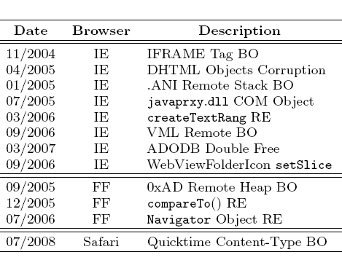
Many heap spray exploits
[RLZ’08]
Improvements: Heap Feng Shui [S’07]
Reliable heap exploits on IE without spraying
Gives attacker full control of IE heap from Javascript

Slide 58

(partial) Defenses
Protect heap function pointers (e.g. PointGuard)
Better browser architecture:
Store JavaScript strings in a separate heap from browser heap
OpenBSD heap overflow protection:
Nozzle [RLZ’08] : detect sprays by prevalence of code on heap
prevents cross-page overflows
non-writable pages

Slide 59
References on heap spraying
[1] Heap Feng Shui in Javascript, by A. Sotirov, Blackhat Europe 2007
[2] Engineering Heap Overflow Exploits with JavaScript M. Daniel, J. Honoroff, and C. Miller, WooT 2008
[3]Nozzle: A Defense Against Heap-spraying Code Injection Attacks, by P. Ratanaworabhan, B. Livshits, and B. Zorn
[4] Interpreter Exploitation: Pointer inference and JiT spraying, by Dion Blazakis

Slide 60
Acknowledgements
Material in this lecture are taken from the slides prepared by:
Prof. Dan Boneh (Standford)

